Slide 1
Generating noisy speech data from clean data in the frequency domain using Deep Learning Methods
Week – 10
Name: Shashank Shirol
University: Manipal Institute of Technology
Duration of the presentation: ~10 mins.

Slide 2
Tasks to be completed:
To try Log Spectral Distortion calculation after thresholding the spectrograms (to reject background clutter).
To see if we can employ edge detection to localize the speech data in a noisy spectrogram (inspired from EdgeGAN)
Modify SinGAN code for better Training:
Study the effects of increasing the number of scales during training.
Try different loss-functions to optimize training on spectrograms.
Modify code for Contrastive Unpaired Translation:
To train with full spectrograms (without resizing)
To directly work with audio signals.

Slide 3

Threshold-Log Spectral Distortion:
Threshold log-based spectrogram to -30 dB i.e. set S[i,j] = 0 where 10*log₁₀(S) < -30;
This method of thresholding is used in the original implementation of spectrogram extraction in MATLAB.
Results:
The results did not vary (a difference of ±0.003)
Scores: (for one example)
LSD (without thresholding): 9.166
LSD (with thresholding): 9.169
GT
Scale=4

Slide 4
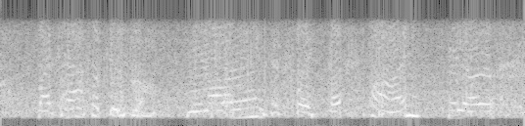
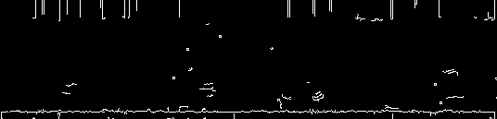
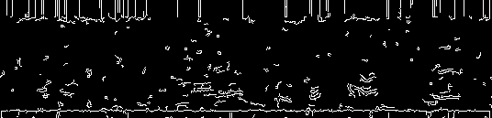
Edge Detection to localize speech activity
Inspired from the EdgeGAN article, I tried to localize speech activity in noisy spectrograms to see if we can apply the technique mentioned in EdgeGAN for our use case.
I used Canny Edge Detection with varying parameters (thresholds) to see which one fit best.
Results:

Slide 5
Modifying SinGAN code: (I)
Studied the effects of varying the number of scales during the training process.
The number of scales affects the learning rate of the model.
This translates to better outputs when generating using the paint2image module.
LSD scores varied when the # of scales changed as follows: ↑ scales → ↓ LSD
LSD Scores:
Number of scales = 7, best LSD = 9.166 (scale = 4)
Number of scales = 5, best LSD = 10.96 (scale = 3)
Scale = 4; # of Scales = 7
Scale = 3; # of Scales = 5

Slide 6
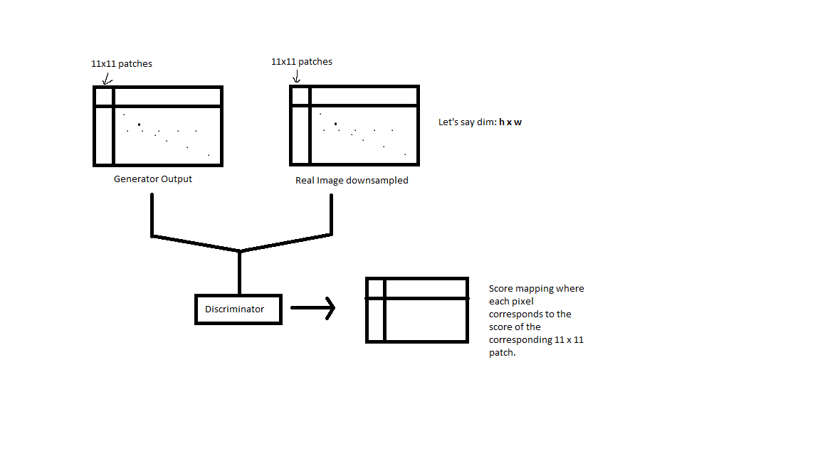
Modifying SinGAN code: (II)
SinGAN implements a Wasserstein GAN – which replaces the discriminator model with a critic that scores the real-ness or fake-ness of a given image.
The loss functions it uses:
Critic Loss = [average critic score on real images] – [average critic score on fake images]
Generator Loss = -[average critic score on fake images]
So, by taking the mean of the critic scores, we were giving equal importance to all the patches.
Tried to vary how the loss was calculated:
Varying the axes of mean, to see if SinGAN learns better

Slide 7
Modifying CUT code: (I)
The original implementation of CUT uses a lot of transforms on the input images. One of the transforms is a resize transform that resizes the input images to a fixed size: 256x256
Modified CUT to use the whole image as is instead of resizing it. This was impossible when using unpaired spectrograms because of the architecture of the model (it needs dim(domainA) == dim(domainB)).
So, we train using paired spectrograms and then generate using another set of spectrograms.
Results:
The LSD scores of the outputs vs ground truth do not vary substantially (±0.02)
Another approach would be to resize domain B spectrograms to match domain A. Since we are only interested in reconstruction of domain A spectrograms.

Slide 8
Modifying CUT code: (II)
Modified the CUT code to directly take audio files as inputs. The spectrogram extraction and all necessary transforms take place internally.
As a part of this modification, I worked on:
Clearing the clutter in the code.
Writing better and customized transforms that have proven to work on spectrograms (from SinGAN).
Added modules for extraction of spectrograms internally and created custom data loaders for spectrograms.
Wrote pre-processing code to store information necessary for reconstruction of audio signals after generation.
The original CUT implementation is convoluted in the sense, it makes use of unnecessary call-backs and custom classes for trivial things. Next objective would be to clean this portion.

Slide 9
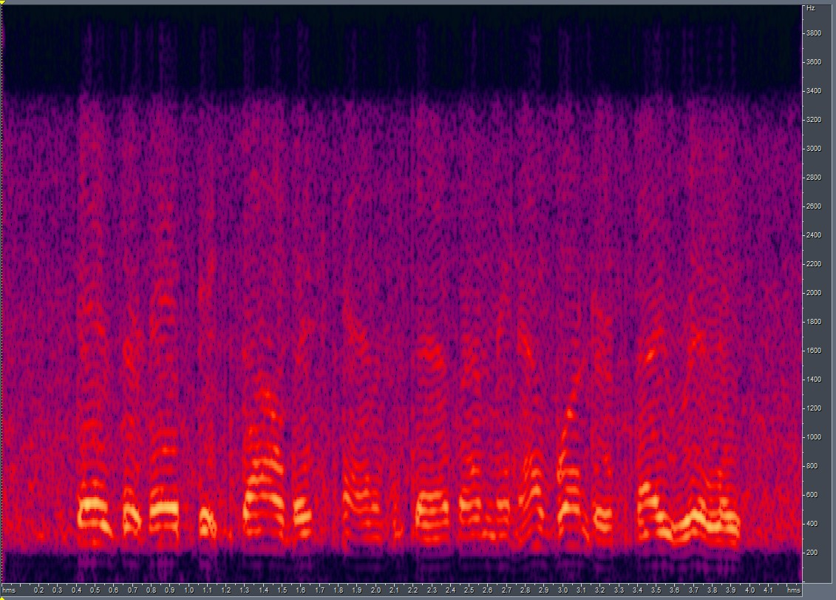
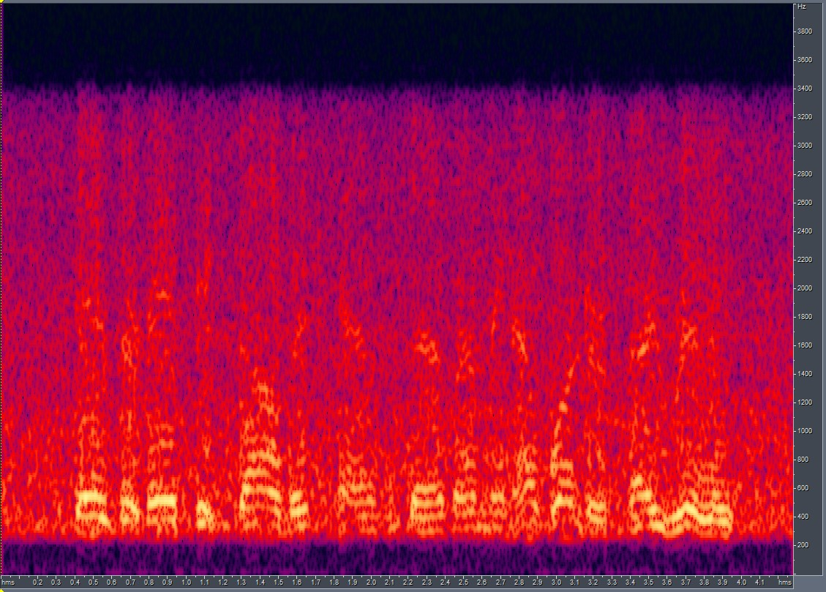
Modifying CUT code: (II) Cont’d
Results:
LSD = 5.55
Generated by CUT
GT

Slide 10
End.

